Slide 1

Made by: Omer iny id:206571739 Stas libman id:337976609
Voting DApp

Slide 2
Known bugs::
Missing implementation of “question to contodate” (***). And random selection of the voter from the voter list to provide the question.
We could not initiate project using the “hardhat” or any other common method. After 10 hours of reaserch we decidet to initiate & deploy the project with “Third Web” platform.

Slide 3
Installation & requirenments and operating the code
No specific instalations needed.
There are two things you need before start:
Active MetaMask account .
The Mumbai network (polygon) in MetaMask (MATIC currency).
VS Code
Node JS
Third web
Truffle
Solidity
Lines of code to run in terminal: in Solidity:
npx thirdweb deploy
In react
npm install
Insert the contract address and the admin wallet to the react project
npm start

Slide 4
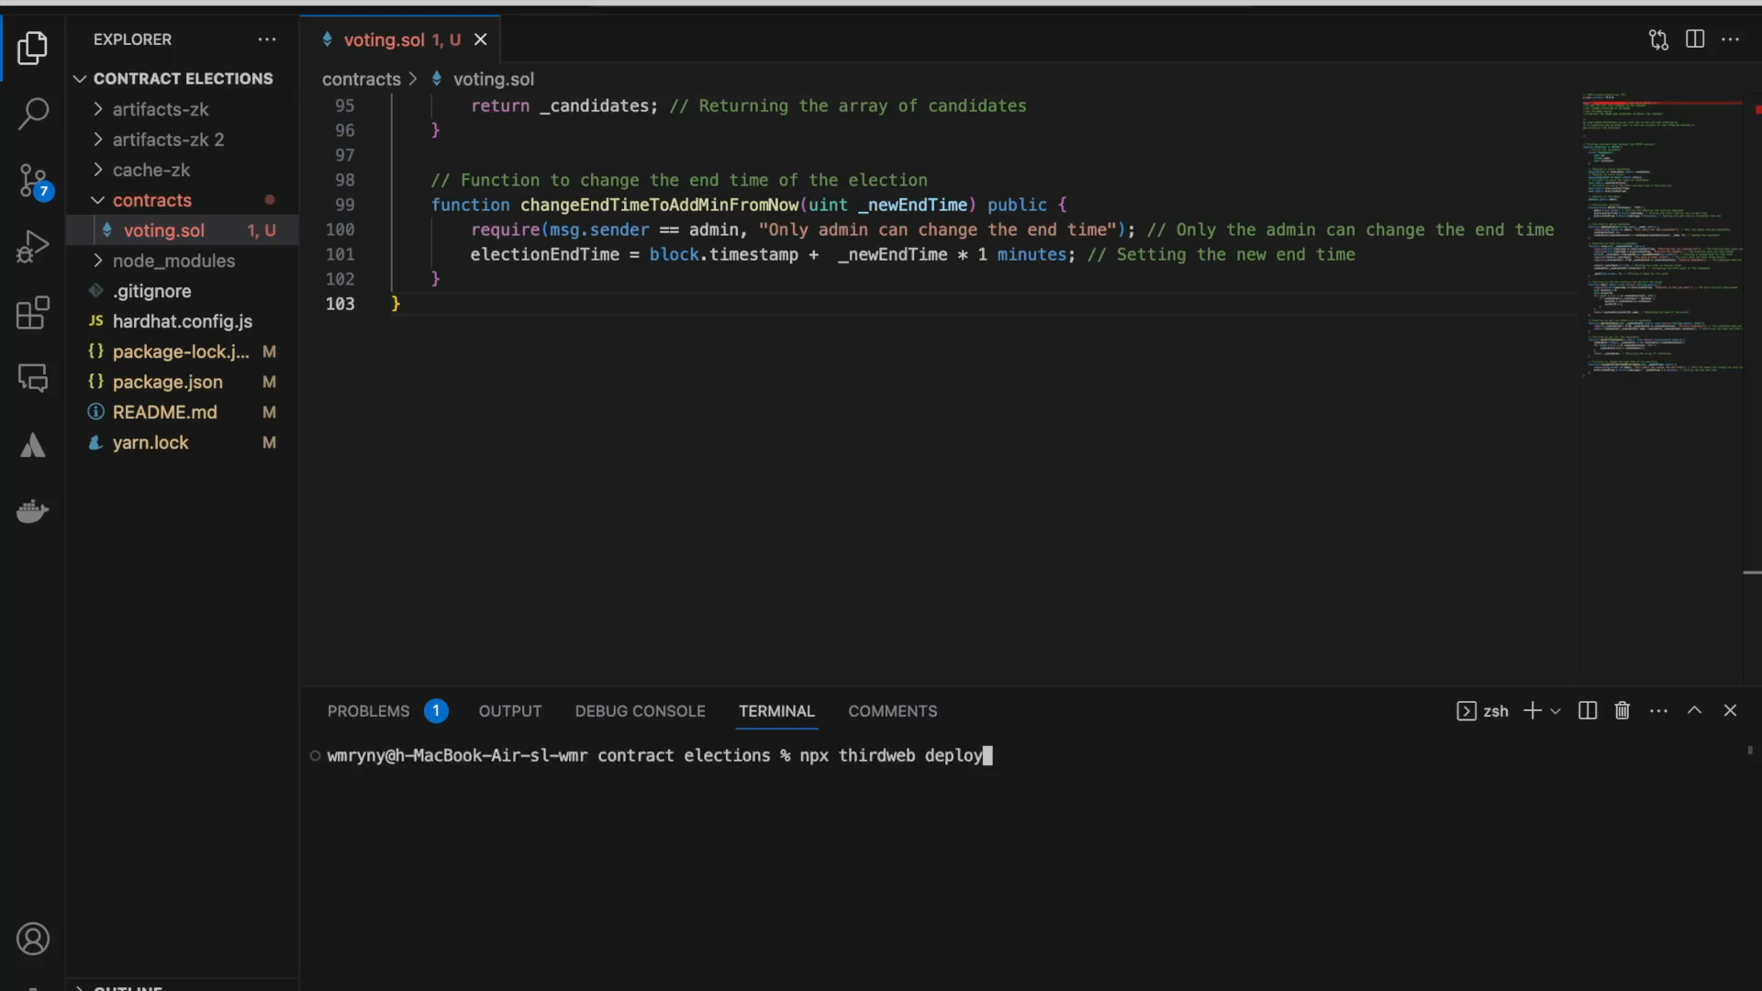
Video of our system

Slide 5
Link to Download full files
https://drive.google.com/drive/folders/12hU5Tgr8tXh-eZJqQML7-I7qGW_uuW6J?usp=share_link

